Slide 1
IREVOLUTION: A DATA-DRIVEN EXPLORATION OF APPLE’S IPHONE IMPACT IN INDIA
-S.Dhanalakshmi

Slide 2
INTRODUCTION:
PURPOSE OUR PROJECT:
Our progect is to explain the pepole’s about the advantages and disadvantages of using Apple iphone.
The invention of the iPhone has affected people's lives and how they do things. It has also set in motion a few trends that wouldn't have been possible without iPhone. Apple has revolutionized communication, playing games, watching movies, listening to music, and more.

Slide 3
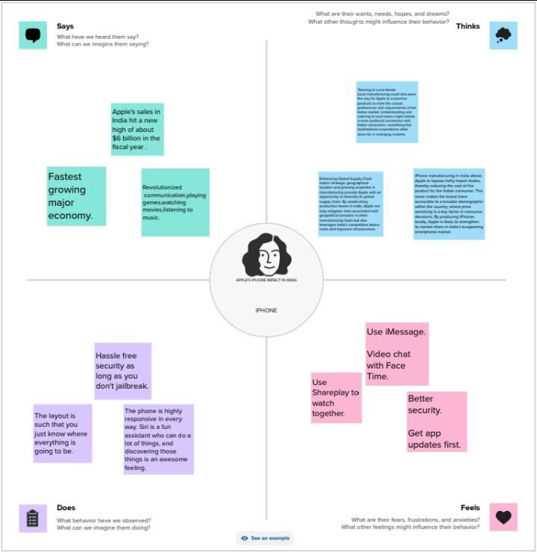
EMPATHY MAP:
We created Empathy Map based on our project. From last 5years to till now how many YouTube channels attained a growth among the people’s all over the world.

Slide 4
BRAINSTORMING MAP
We created Brainstorming Map based on our project. From last 5 years to till now how many Apple’s iphone attained a growth among the people’s all over the world we create Brainstorming Map.

Slide 5
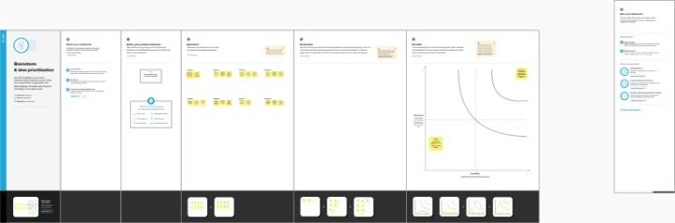

Slide 6
Apple Mobiles Price List | Price | Gadgets 360 Rating
Apple iPhone 15 Pro Max | Rs. 1,59,900 | -
Apple iPhone 15 Pro | Rs. 1,34,900 | -
Apple iPhone 15 Plus | Rs. 89,900 | -
Apple iPhone 15 | Rs. 79,900 | -
iPhone 14 | Rs. 56,999 | 9
iPhone 14 Plus | Rs. 65,999 | 9
iPhone 14 Pro | Rs. 1,19,990 | 9
iPhone 14 Pro Max | Rs. 1,27,999 | -
Apple iPhone SE (2022) | Rs. 32,699 | 7
iPhone 13 Pro Max | Rs. 1,13,900 | 9
Open refine:
Before visualizing, I first used OpenRefine to clean the dataset. Compared with tools such as R and Excel, OpenRefine simplifies the process of cleaning and standardizing data through functions like filtering, clustering, and text manipulation, resulting in efficient data preparation for analysis. For this dataset, I discovered several’0 values’ in video views and counts variable as well as several null values in the category variable.

Slide 7

TABLEAU PUBLIC:
Tableau Public is a free platform to explore, create and publicly share data visualizations online. With the largest repository of data visualizations in the world to learn from, Tableau Public makes developing data skills easy.

Slide 8
BAR CHART:
WE CREATE OUR BAR WITH THE INFORMATION
PRODUCT NAME WITH THEIR SALES PRICE IN APPLE IPHONE

Slide 9
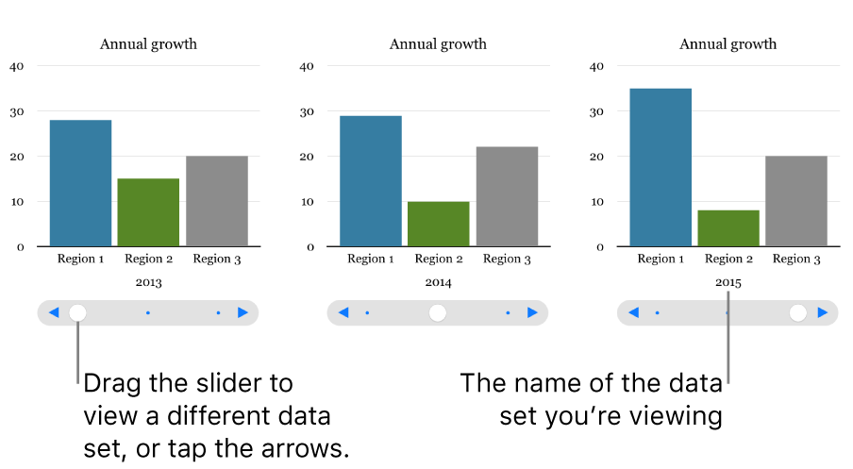
COMPARISATION OF MEASURES VALUE AND AVG. RANK :
GRAPHICAL VISION

Slide 10
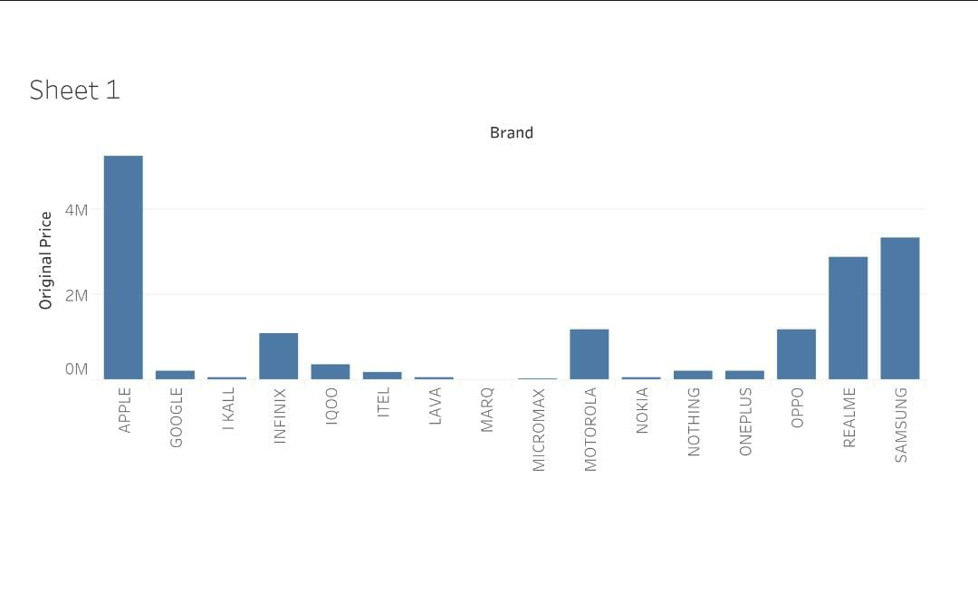
THIS BAR CHART REPRESENTS THE DIFFERENT TYPES OF MOBILES THAT SALES ON THE FLIPKART (BRAND) AND THEIR ORIGINAL PRICE

Slide 11
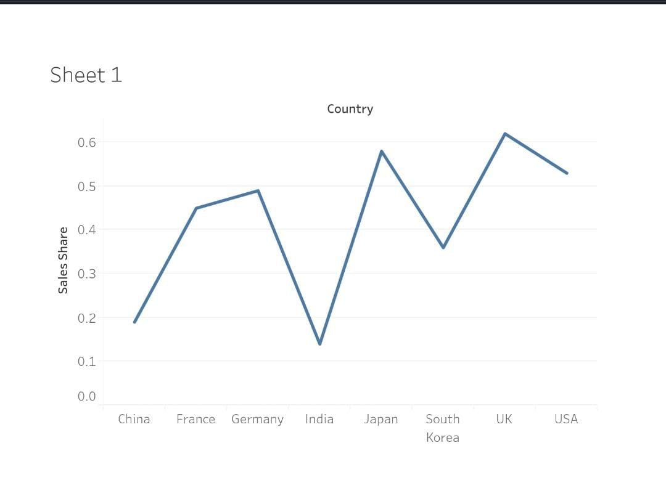
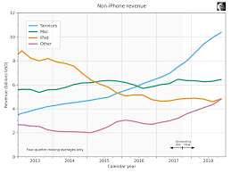
GRAPHICAL VISION OF COUNT OF RANK AND PRIMARY LANGUAGE: SHEET 1:

Slide 12
PIE CHART:
The pie-chart gives us an idea about how the people’s usage of iphone in today’s world. Clearly, it depicts a brief vision among us!
Iphone can also be used as a repository for students digital work. Learners can set up their own company, and then save projects there with the added value of attracting public feedback, which in turn raises the standard of their work.
Iphone is the most common social media service used to communicate with students. Not surprising, this communication tool provides an alternative to traditional methods of sharing information, including lectures, podcasts, and current news.

Slide 13
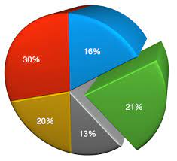
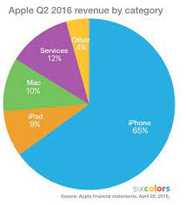
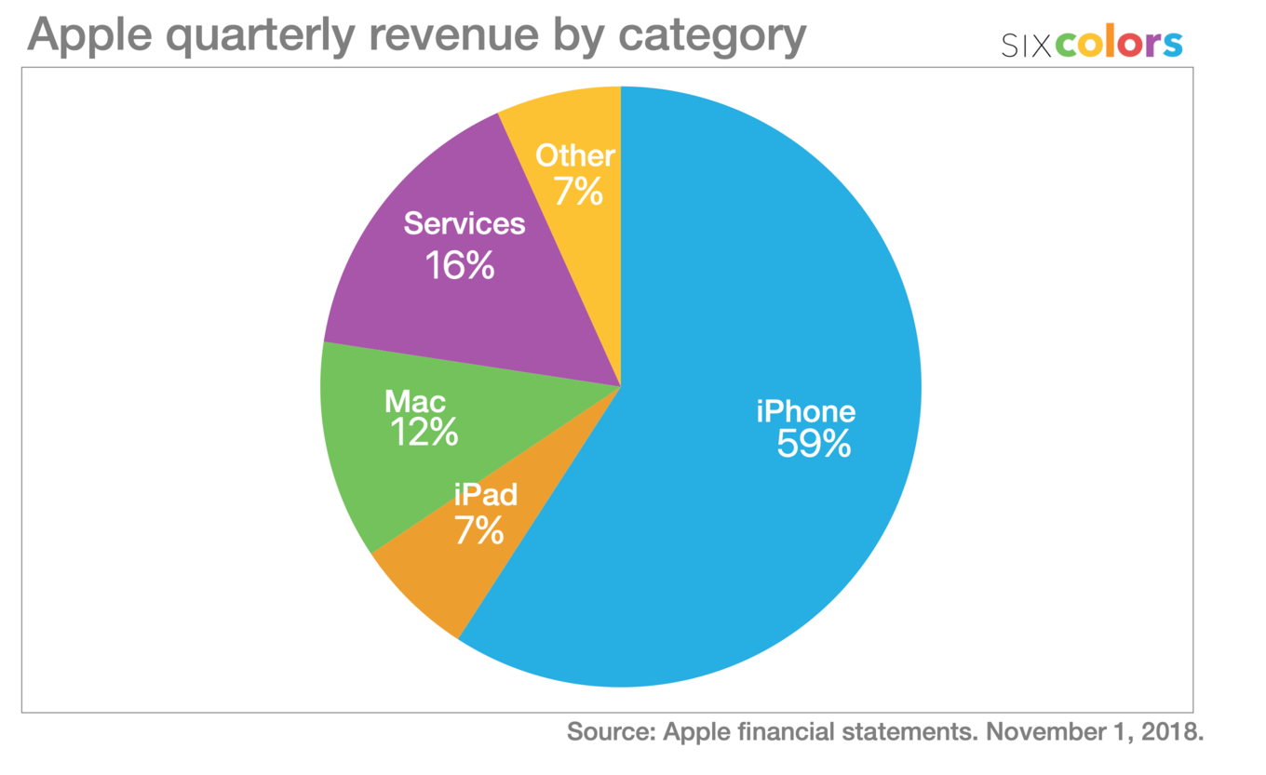

Slide 14
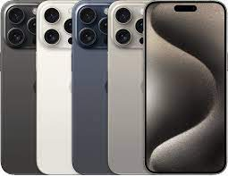
APPLE’S IPHONE MODELS AND PRICES:
iPhone 15 Pro Max. Year introduced: 2023. ...
iPhone 15 Pro. Year introduced: 2023. ...
iPhone 15 Plus. Year introduced: 2023. ...
iPhone 15. Year introduced: 2023. ...
iPhone 14 Pro Max. Year introduced: 2022. ...
iPhone 14 Pro. Year introduced: 2022. ...
iPhone 14 Plus. Year introduced: 2022. ...
iPhone 14. Year introduced: 2022.

Slide 15
APPLE’S IPHONE A17 PRO
Performance
Hexa Core (3.46 GHz, Dual Core + 2.02 GHz, Quad core) Apple A16 Bionic 6 GB RAM
Display
6.1 inches (15.49 cm) 461 PPI, OLED 60 Hz Refresh Rate
Camera
48 MP + 12 MP Dual Primary Cameras Dual-color LED Flash 12 MP Front Camera
Battery
3349 mAh Fast Charging USB Type-C Port
Apple iPhone 13
iOS v15
Rs.50,999See more prices
Performance
Hexa Core (3.23 GHz, Dual Core + 1.82 GHz, Quad core) Apple A15 Bionic 4 GB RAM
Display
6.1 inches (15.49 cm) 457 PPI, OLED 60 Hz Refresh Rate
Camera
12 MP + 12 MP Dual Primary Cameras Dual LED Flash 12 MP Front Camera
Battery
94%

Slide 16
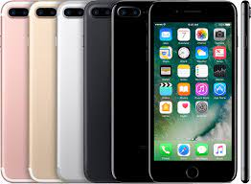
APPLE’S IPHONE 15
Performance
Hexa Core (3.78 GHz, Dual Core + 2.11 GHz, Quad core) Apple A17 Pro 8 GB RAM
Display
6.7 inches (17.02 cm) 460 PPI, OLED 120 Hz Refresh Rate
Camera
48 MP + 12 MP + 12 MP Triple Primary Cameras Dual-color LED Flash 12 MP Front Camera
Battery
4422 mAh Fast Charging USB Type-C Port

Slide 17
CONCLUSION:
The main conclusion that can be drawn is we found to be the most interesting about Apple is how they are very innovative and early adapters. Apple is usually the first company to come out with a new product line before anyone else. This is very risky but it seems to be working to Apples advantage.
Owning an iPhone comes with a lot of benefits. A great camera, fast speed, and a user-friendly interface are just a few of the perks you get with this device. However, with so many iPhone options available in the market, it can be hard to decide which model to get.
THANK YOU ALL…

